Slide 1
Data Science Marathon
Research & Academic Collaboration Program (RACP) – 2018

Slide 2
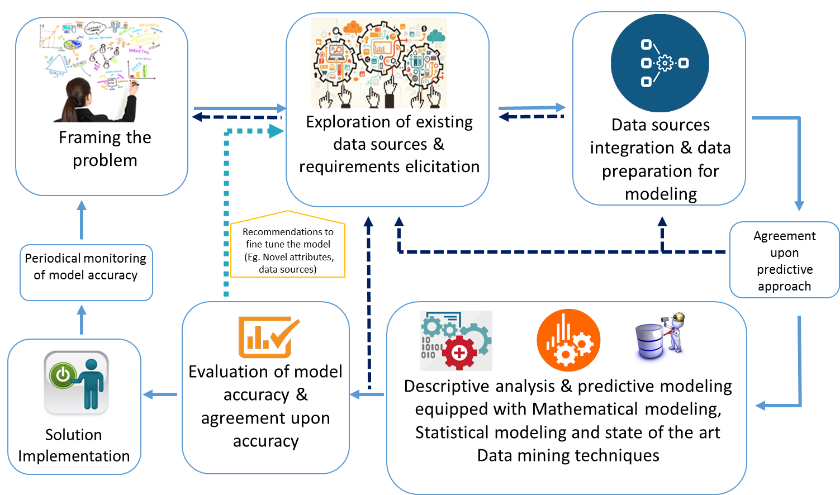
Data science solutions approach

Slide 3
Data files
File 01 - Sales Data.csv
Sales quantity data with time of sales
File 02 - Sales Data.csv
Sales quantity data with time of sales
Product.csv
Product information
Retailer.csv
Retailer information

Slide 4
Objective
How data science can help to increase the sales of grocery items ?

